Slide 1

Introduction to Apache NIFI
AUTOMATION OF THE FLOW OF DATA BETWEEN SYSTEMS

Slide 2
SUMMARY REVIEW
Introduction to NiFi
NiFi User Interface
Important terminologies
Application architecture
High level overview of key features
Components

Slide 3
WHAT IS NIFI
Apache NiFi is a dataflow system based on the concepts of flow-based programming. It supports powerful and scalable directed graphs of data routing, transformation, and system mediation logic.
It was built to automate the flow of data between systems.
While the term 'dataflow' is used in a variety of contexts, we use it here to mean the automated and managed flow of information between systems.

Slide 4
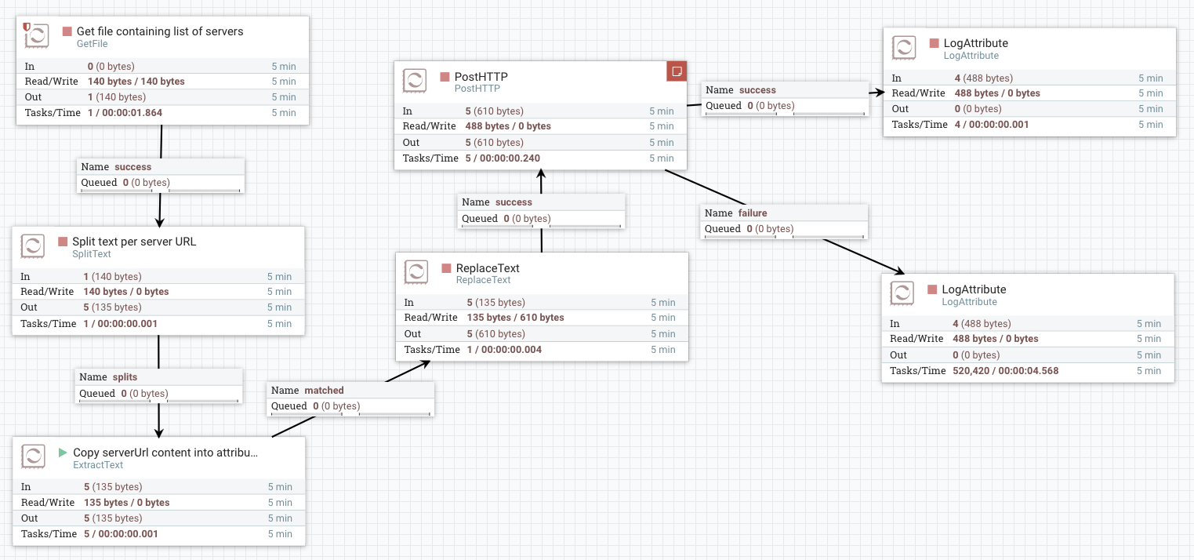
WHAT IS NIFI

Slide 5
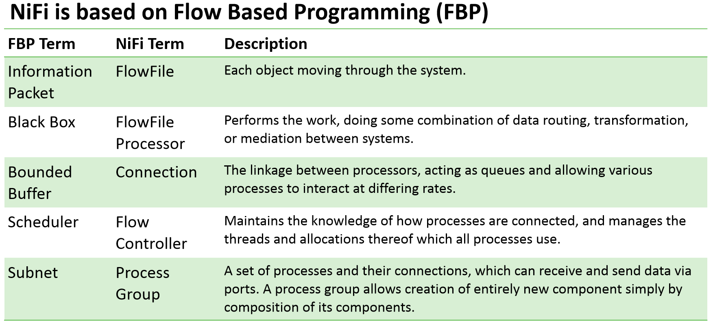
WHAT IS NIFI

Slide 6
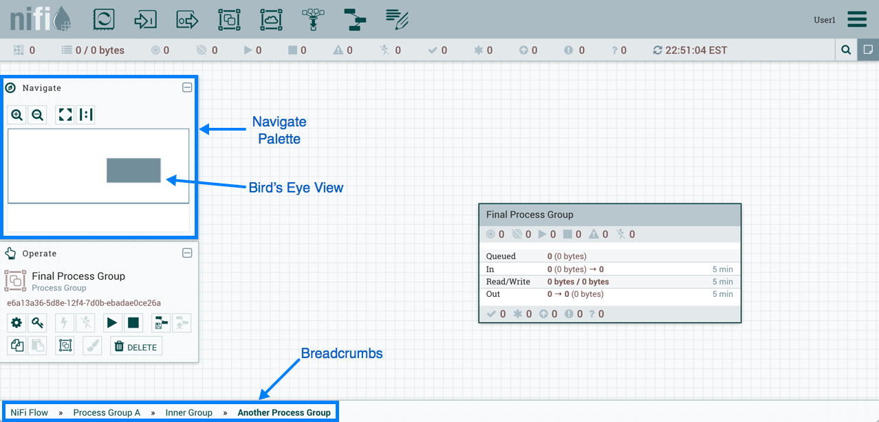
NIFI User Interface

Slide 7
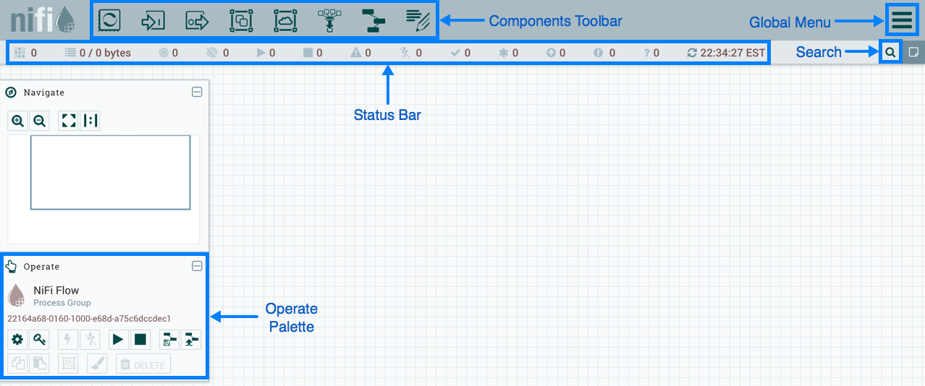
NIFI User Interface

Slide 8
Terminology
DataFlow Manager: A DataFlow Manager (DFM) is a NiFi user who has permissions to add, remove, and modify components of a NiFi dataflow.
FlowFile: The FlowFile represents a single piece of data in NiFi. A FlowFile is made up of two components: FlowFile Attributes and FlowFile Content. Content is the data that is represented by the FlowFile. Attributes are characteristics that provide information or context about the data; they are made up of key-value pairs. All FlowFiles have the following Standard Attributes:
uuid: A unique identifier for the
FlowFile filename: A human-readable filename that may be used when storing the data to disk or in an external service
Path: A hierarchically structured value that can be used when storing data to disk or an external service so that the data is not stored in a single directory

Slide 9
Terminology
Processor: The Processor is the NiFi component that is used to listen for incoming data; pull data from external sources; publish data to external sources; and route, transform, or extract information from FlowFiles.
Relationship: Each Processor has zero or more Relationships defined for it. These Relationships are named to indicate the result of processing a FlowFile. After a Processor has finished processing a FlowFile, it will route (or “transfer”) the FlowFile to one of the Relationships. A DFM is then able to connect each of these Relationships to other components in order to specify where the FlowFile should go next under each potential processing result.

Slide 10
Terminology
Connection: Provide the actual linkage between processors. These act as queues and allow various processes to interact at differing rates. For each Connection that is drawn, a DFM can determine which Relationships should be used for the Connection. This allows data to be routed in different ways based on its processing outcome. Each connection houses a FlowFile Queue. When a FlowFile is transferred to a particular Relationship, it is added to the queue belonging to the associated Connection.
Controller Service: Controller Services are extension points that, after being added and configured by a DFM in the User Interface, will start up when NiFi starts up and provide information for use by other components (such as processors or other controller services. They provide access to a shared resource, such as a database or ssl context, or externally managed content.

Slide 11
Terminology
Reporting Task: Reporting Tasks run in the background to provide statistical reports about what is happening in the NiFi instance. The DFM adds and configures Reporting Tasks in the User Interface as desired. Common reporting tasks include the ControllerStatusReportingTask, MonitorDiskUsage reporting task, MonitorMemory reporting task, and the StandardGangliaReporter.
Funnel: A funnel is a NiFi component that is used to combine the data from several Connections into a single Connection.
Process Group: When a dataflow becomes complex, it often is beneficial to reason about the dataflow at a higher, more abstract level. NiFi allows multiple components, such as Processors, to be grouped together into a Process Group. The NiFi User Interface then makes it easy for a DFM to connect together multiple Process Groups into a logical dataflow, as well as allowing the DFM to enter a Process Group in order to see and manipulate the components within the Process Group.

Slide 12
Terminology
Port: Dataflows that are constructed using one or more Process Groups need a way to connect a Process Group to other dataflow components. This is achieved by using Ports. A DFM can add any number of Input Ports and Output Ports to a Process Group and name these ports appropriately.
Remote Process Group: Just as data is transferred into and out of a Process Group, it is sometimes necessary to transfer data from one instance of NiFi to another. While NiFi provides many different mechanisms for transferring data from one system to another, Remote Process Groups are often the easiest way to accomplish this if transferring data to another instance of NiFi.
Bulletin: The NiFi User Interface provides a significant amount of monitoring and feedback about the current status of the application. In addition to rolling statistics and the current status provided for each component, components are able to report Bulletins. Whenever a component reports a Bulletin, a bulletin icon is displayed on that component.

Slide 13
Terminology
Template: Often times, a dataflow is comprised of many sub-flows that could be reused. NiFi allows DFMs to select a part of the dataflow (or the entire dataflow) and create a Template. This Template is given a name and can then be dragged onto the canvas just like the other components.
flow.xml.gz: Everything the DFM puts onto the NiFi User Interface canvas is written, in real time, to one file called the flow.xml.gz. This file is located in the nifi/conf directory by default. Any change made on the canvas is automatically saved to this file, without the user needing to click a "save" button. In addition, NiFi automatically creates a backup copy of this file in the archive directory when it is updated. You can use these archived files to rollback flow configuration.

Slide 14
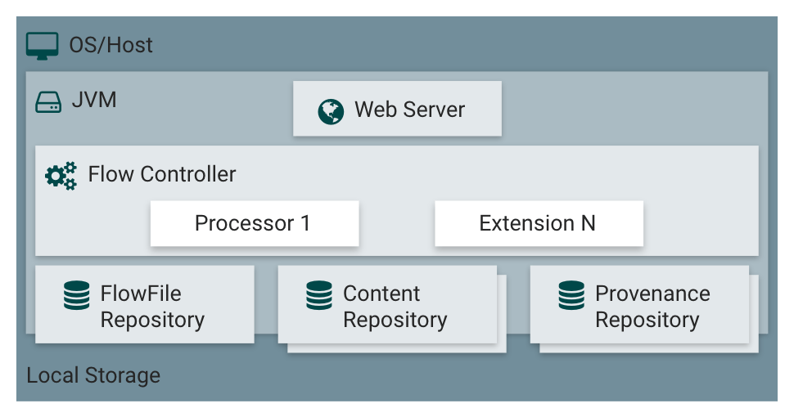
Architecture
The Web Server
Enables us to access NiFi’s User Interface from the web browser.
The Flow Controller
Acts as the brains of the operation, it gives threads to extensions (custom processors), and keeps track of all the operations being executed by extensions
The FlowFile Repository
Is the area NiFi keeps track of all the status updates regarding FlowFiles as they travel throughout the DataFlow
The Content Repository
Is the location the content bytes of FlowFiles reside.
The Provenance Repository
Consists of all the provenance event data.

Slide 15
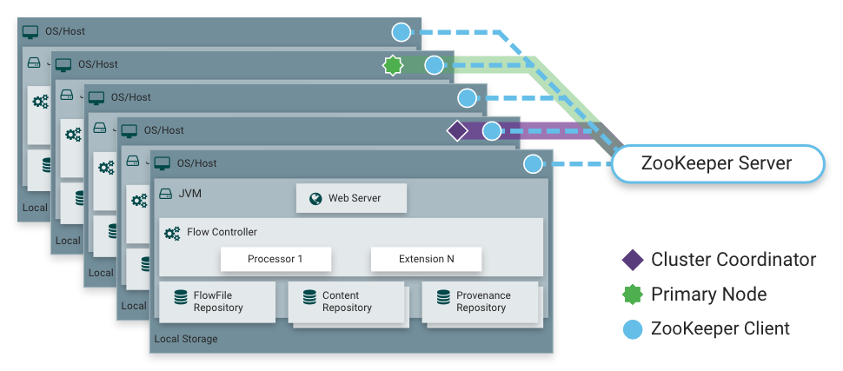
Architecture
NiFi is also able to operate within a cluster.
A Zero-Master Clustering paradigm is employed.
Each node in a NiFi cluster performs the same tasks on the data, but each operates on a different set of data.
Apache ZooKeeper elects a single node as the Cluster Coordinator, and failover is handled automatically by ZooKeeper.
All cluster nodes report heartbeat and status information to the Cluster Coordinator. The Cluster Coordinator is responsible for disconnecting and connecting nodes.
Additionally, every cluster has one Primary Node, also elected by ZooKeeper.
As a DataFlow manager, you can interact with the NiFi cluster through the user interface (UI) of any node. Any change you make is replicated to all nodes in the cluster, allowing for multiple entry points.

Slide 16
High Level Overview of Key NiFi Features
The key features categories include flow management, ease of use, security, extensible architecture, and flexible scaling model
Flow Management
Guaranteed Delivery -Achieved through effective use of a purpose-built persistent write-ahead log and content repository. Together they are designed in such a way as to allow for very high transaction rates, effective load-spreading, copy-on-write, and play to the strengths of traditional disk read/writes.
Data Buffering w/ Back Pressure and Pressure Release -NiFi supports buffering of all queued data as well as the ability to provide back pressure as those queues reach specified limits or to age off data as it reaches a specified age (its value has perished).
Prioritized Queuing -NiFi allows the setting of one or more prioritization schemes for how data is retrieved from a queue. The default is oldest first, but there are times when data should be pulled newest first, largest first, or some other custom scheme.

Slide 17
High Level Overview of Key NiFi Features
Flow Specific QoS (latency v throughput, loss tolerance, etc.) -There are points of a dataflow where the data is absolutely critical and it is loss intolerant. There are also times when it must be processed and delivered within seconds to be of any value. NiFi enables the fine-grained flow specific configuration of these concerns.
Ease of Use Visual Command and Control -NiFi enables not only the visual establishment of dataflows but it does so in realtime. Rather than being 'design and deploy' it is much more like molding clay. If you make a change to the dataflow that change immediately takes effect. Changes are fine-grained and isolated to the affected components. You don’t need to stop an entire flow or set of flows just to make some specific modification.
Flow Templates -Templates allow subject matter experts to build and publish their flow designs and for others to benefit and collaborate on them.
Data Provenance -NiFi automatically records, indexes, and makes available provenance data as objects flow through the system even across fan-in, fan-out, transformations, and more.

Slide 18
High Level Overview of Key NiFi Features
Recovery / Recording a rolling buffer of fine-grained history NiFi’s content repository is designed to act as a rolling buffer of history. Data is removed only as it ages off the content repository or as space is needed. This combined with the data provenance capability makes for an incredibly useful basis to enable click-to-content, download of content, and replay, all at a specific point in an object’s lifecycle which can even span generations.
Security
System to System -A dataflow is only as good as it is secure. NiFi at every point in a dataflow offers secure exchange through the use of protocols with encryption such as 2-way SSL. In addition NiFi enables the flow to encrypt and decrypt content and use shared-keys or other mechanisms on either side of the sender/recipient equation.
User to System -NiFi enables 2-Way SSL authentication and provides pluggable authorization so that it can properly control a user’s access and at particular levels (read-only, dataflow manager, admin). If a user enters a sensitive property like a password into the flow, it is immediately

Slide 19

Components
Processor:
The Processor is the most commonly used component, as it is responsible for
Data ingress,
Data egress,
Routing, and manipulating
There are many different types of Processors. In fact, many vendors may implement their own Processors to perform whatever functions are necessary for their use case.

Slide 20
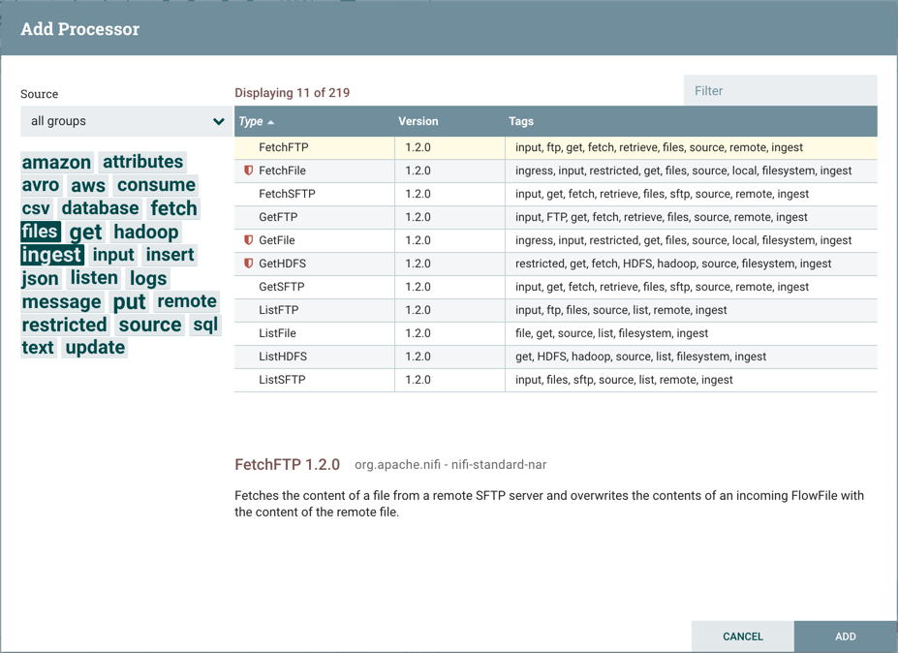
Components
When a Processor is dragged onto the canvas, the user is presented with a dialog to choose which type of Processor to use:

Slide 21
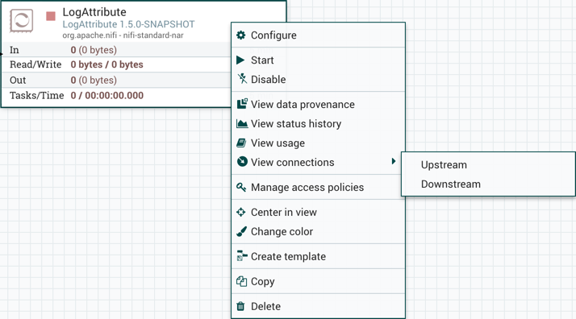
Components
Once you have dragged a Processor onto the canvas, you can interact with it by right-clicking on the Processor and selecting an option from the context menu. The options available to you from the context menu vary, depending on the privileges assigned to you.

Slide 22
Components
Context Menu options explained :
https://nifi.apache.org/docs/nifi-docs/html/user-guide.html#building-dataflow

Slide 23

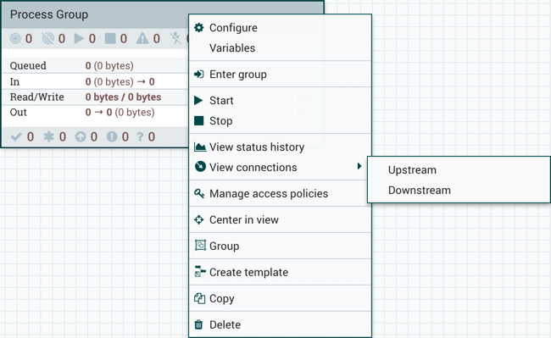
Components
Process Group: Process Groups can be used to logically group a set of components so that the dataflow is easier to understand and maintain. When a Process Group is dragged onto the canvas, the DFM is prompted to name the Process Group. All Process Groups within the same parent group must have unique names. The Process Group will then be nested within that parent group.

Slide 24

Components
Remote Process Group: Remote Process Groups appear and behave similar to Process Groups. However, the Remote Process Group (RPG) references a remote instance of NiFi.
When an RPG is dragged onto the canvas, rather than being prompted for a name, the DFM is prompted for the URL of the remote NiFi instance.
If the remote NiFi is a clustered instance, the URL that should be used is the URL of any NiFi instance in that cluster.
When data is transferred to a clustered instance of NiFi via an RPG, the RPG will first connect to the remote instance whose URL is configured to determine which nodes are in the cluster and how busy each node is. This information is then used to load balance the data that is pushed to each node. The remote instances are then interrogated periodically to determine information about any nodes that are dropped from or added to the cluster and to recalculate the load balancing based on each node’s load.

Slide 25
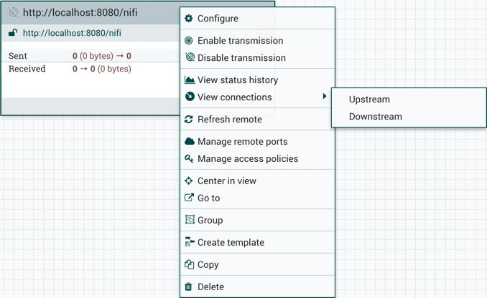
Components

Slide 26
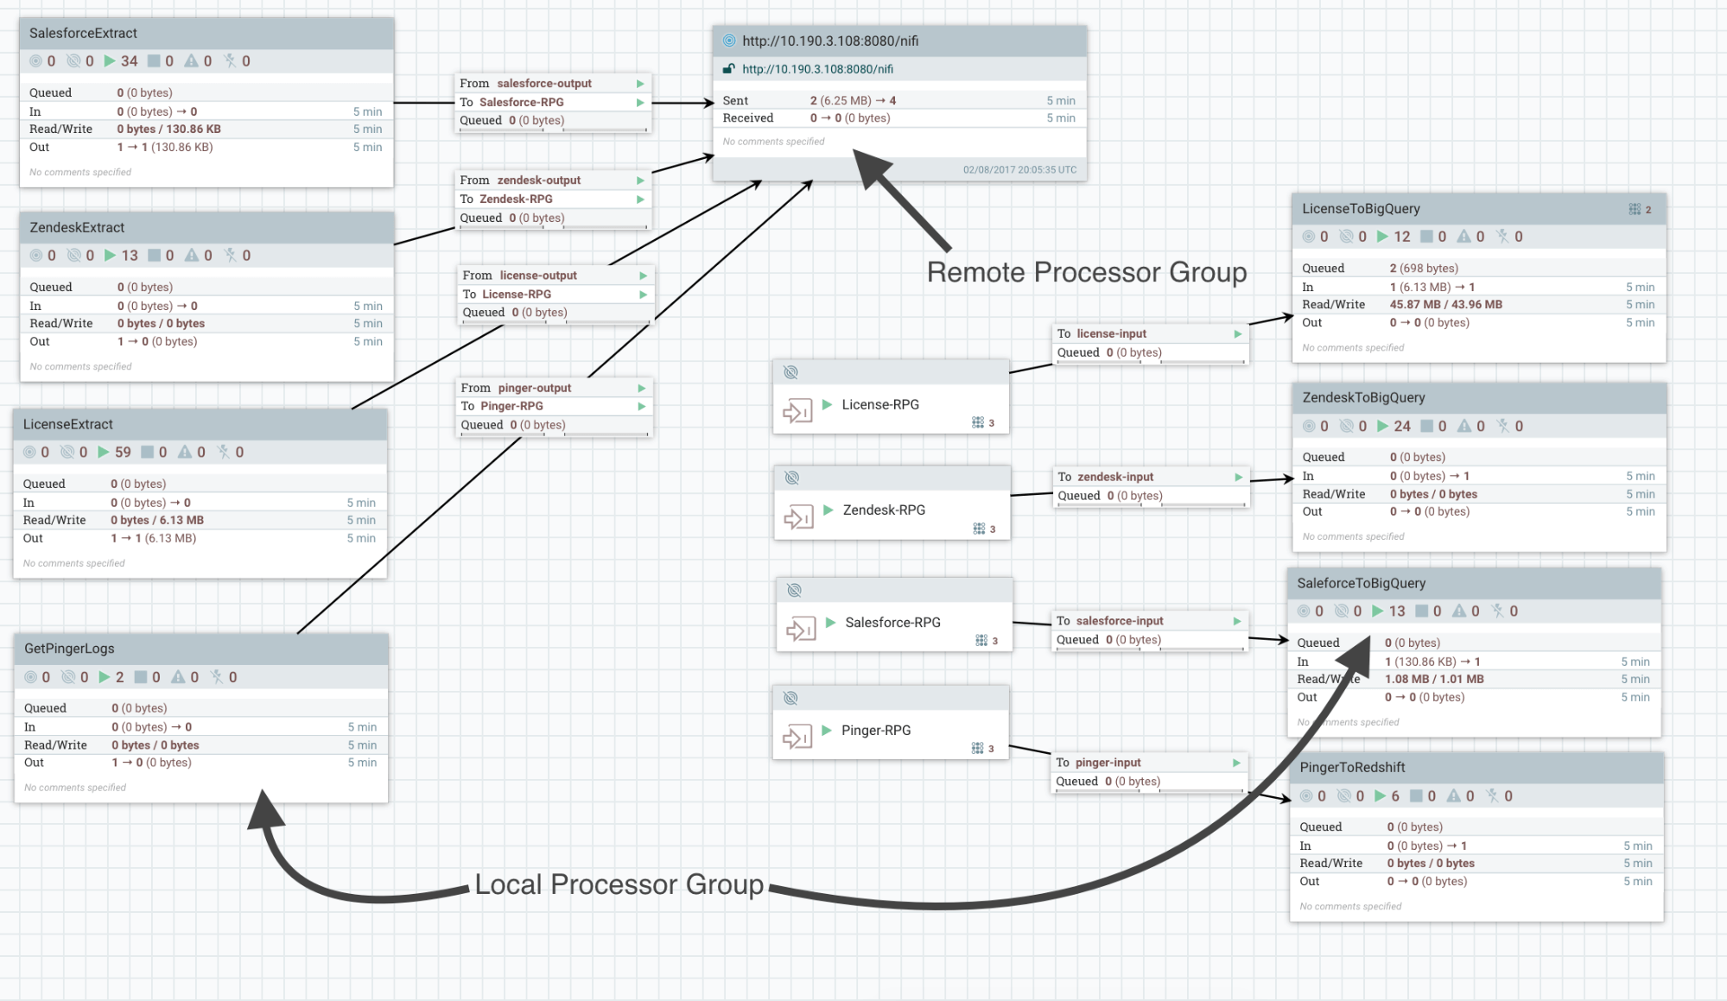
Components

Slide 27
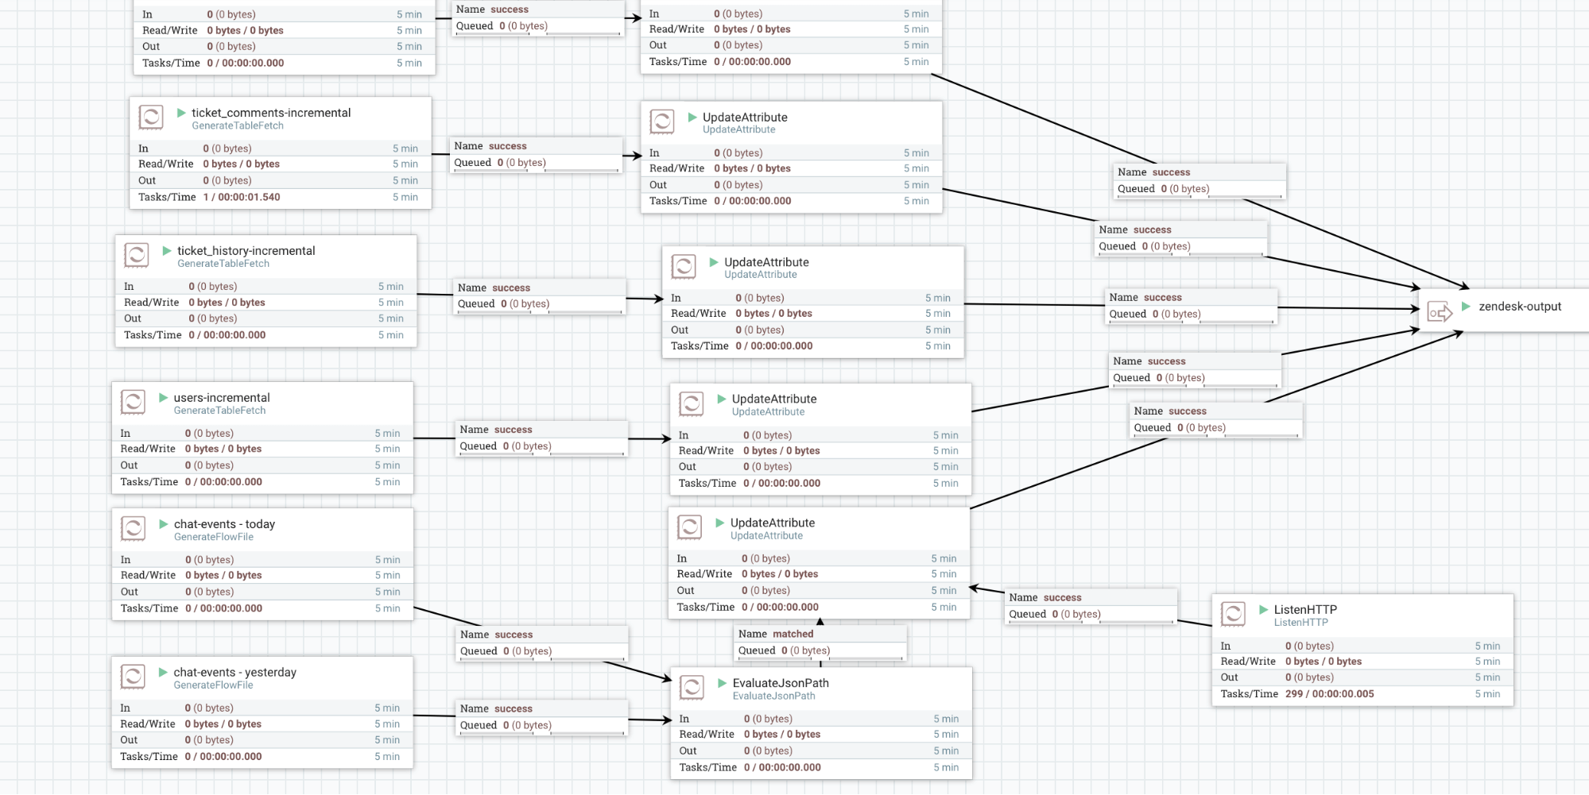
Components
ZendeskExtract process group

Slide 28
Templates
At times, using the small building blocks can become tedious if the same logic needs to be repeated several times. To solve this issue, NiFi provides the concept of a Template.
A Template is a way of combining these basic building blocks into larger building blocks. Once a DataFlow has been created, parts of it can be formed into a Template. This Template can then be dragged onto the canvas, or can be exported as an XML file and shared with others.
Templates received from others can be imported into an instance of NiFi and dragged onto the canvas.
More information on templates can be found here:
https://nifi.apache.org/docs/nifi-docs/html/user-guide.html#templates
Collection of useful templates for learning about how to build DataFlows with the existing Processors can be found here:
https://cwiki.apache.org/confluence/display/NIFI/Example+Dataflow+Templates

Slide 29
References
https://nifi.apache.org/docs/nifi-docs/html/user-guide.html
https://nifi.apache.org/docs/nifi-docs/html/getting-started.html
https://docs.hortonworks.com/HDPDocuments/HDF3/HDF-3.1.2/bk_user-guide/content/ch01s01.html
https://nifi.apache.org/docs/nifi-docs/html/user-guide.html#templates
https://ddewaele.github.io/http-communication-with-apache-nifi/
29
Notes:
PRESENTATIONS 101 – RULE OF 3
1 – Tell them what you’re gonna tell them
2 – Tell them
3 – TELL THEM WHAT YOU TOLD THEM - Overview bullets REPEATED, with DETAILED SUB-BULLETS providing skill.

